Slide 1
AUSPIFY TECHNOLOGIES · INTERNSHIP SUMMARY
C/C++
Development
Internship
Project Work and Learning Summary
MUHAMMAD IBRAHIM · C/C++ DEVELOPMENT INTERN · 4 WEEKS
Projects covered: Tasks 3, 4, 5, and 6
ID: AT/INT/2034723

Slide 2




INTERNSHIP OUTCOME
The internship turned C++ fundamentals into working console applications
Applied fundamentals
Built console apps
Separated code
Tested behavior
Used C++ concepts in practical tasks.
Created menu-driven user interfaces.
Organized source and header files.
Checked expected behavior and invalid input.
Documentation and screenshot evidence supported the project demonstrations.

Slide 3

WORKFLOW
Source files become executable programs through a repeatable workflow
FILES
TOOLS
.cpp source files and .h header files
C++ with G++ / MinGW where applicable
Source + headers
Compiler
Executable
STORAGE
VERSIONING
Text-file storage where implemented
Git and GitHub only where completed in the workflow
Console interaction

Slide 4
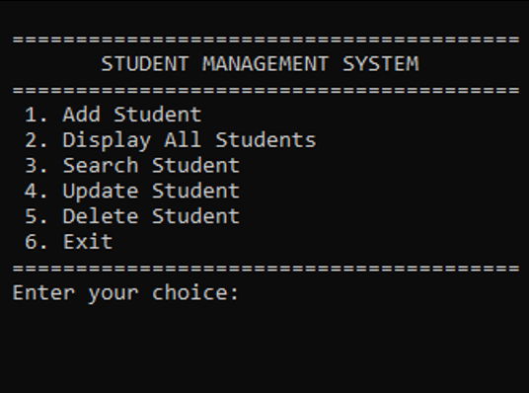
TASK 3
Student records are managed through a modular console system
Purpose: manage student records in a C++ console application.
Supported operations include adding, displaying, searching, updating, or deleting records.
Student data file: students.txt
Source separation: main.cpp · Student.cpp · Student.h

Slide 5
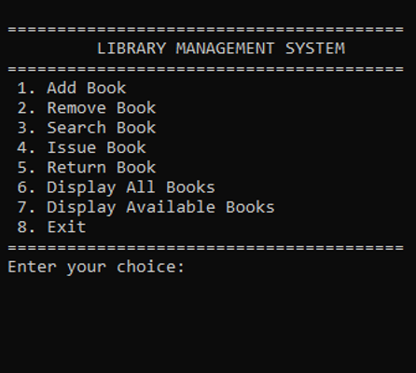
TASK 4
Library records support practical book-management workflows
Purpose: manage library book records in a C++ console application.
Supported operations
Adding, displaying, searching, removing, and issue/return.
Source files
main.cpp · Book.cpp · Book.h · Library.cpp · Library.h
Data file
Books.txt

Slide 6
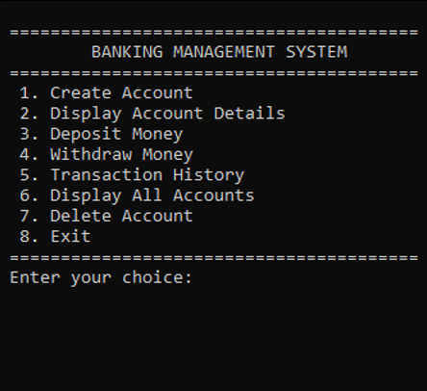
TASK 5
Account operations
demonstrate basic banking
logic
Educational console application for account
management and balance operations—not a
production banking system.
Supported operations
Creating or managing accounts, displaying information, deposits, and withdrawals.
Source files
main.cpp · Account.cpp · Account.h · Bank.cpp · Bank.h
Data file:
accounts.txt

Slide 7
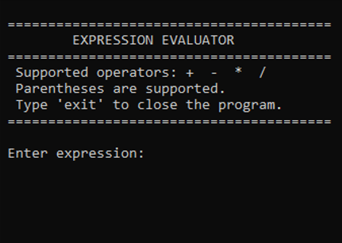
TASK 6
Expression evaluation
depends on parsing and
precedence
Evaluate arithmetic expressions in C++. Handle operator precedence and grouped expressions where supported.
Validation: Validate malformed input and handle division by zero where implemented.
Illustrative expression
[4 + {5 - (6 * 8)}] / 9
Use only operators, bracket types, and error conditions supported by the final code.

Slide 8

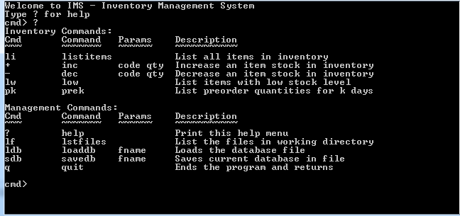
DEMONSTRATION AND TESTING
Project demonstrations pair real evidence with a disciplined testing approach
DEMONSTRATION A
DEMONSTRATION B
Testing approach
Compile and run the main workflows.
Verify menu options, record handling, and text-file persistence where applicable.
Test invalid input, expression edge cases, and the intended working directory.

Slide 9




LEARNING OUTCOMES
Challenges became practical learning outcomes in C++ development
Expression processing
Input validation
Grouped expressions · operator precedence · parsing · evaluation logic
Unexpected console input · error handling · reliability
File handling
Modular C++ design
Text-file records where applicable · relative paths · working directories
Classes · functions · source files · headers · object-oriented programming · separation of responsibilities
SKILLS DEVELOPED
C++ (OOP and DSA) · debugging · testing · technical documentation · project presentation

Slide 10

CLOSING SUMMARY
Four console applications created a practical foundation for continued development
Student Management System
Library Management System
Banking Management System
Expression Evaluator
GitHub Repository URL:
https://github.com/Muhammad-Ibrahim586/Auspify-Technologies-C-Cpp-Development-Internship
MUHAMMAD IBRAHIM — C/C++ DEVELOPMENT INTERN

